Slide 1
ETL Project
Project Topic: Happiness & Life expectancy
Group Members
Jasjeet Kaur
Erika Hoshino
Saleha Khatun
Phimnarin Aksupak

Slide 2

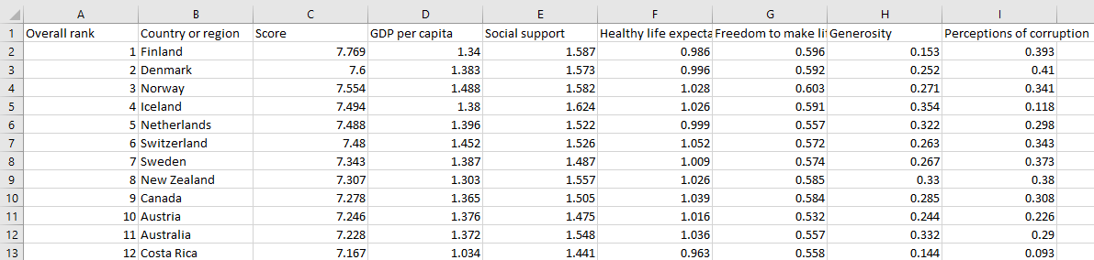
Key Datasets
Data source: Kaggle.com
Data set 1
World Happiness Report (2015-2021 )
world-happiness-report|Kaggle
Contains happiness rankings and factors affecting these rankings for 156 countries from last 7 years
This dataset is helpful for the governments and organisations to inform their policy making in areas like well being, health and finance
The data was collected through a survey/poll
csv file format

Slide 3
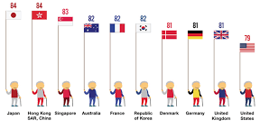
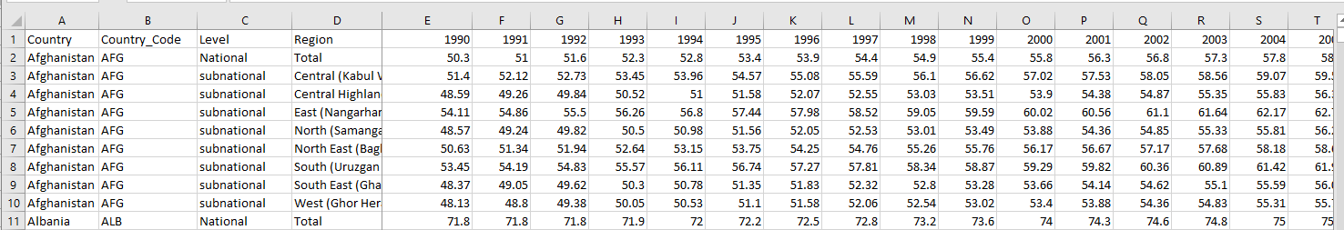
Key Datasets
Data source: Kaggle.com
Data set 2
Human life expectancy dataset (1990-2019)
Human Life Expectancy Around the World | Kaggle
contains maximum number of years an individual from the human species can live
comprises data of 186 countries for the last 20 years
csv file format

Slide 4
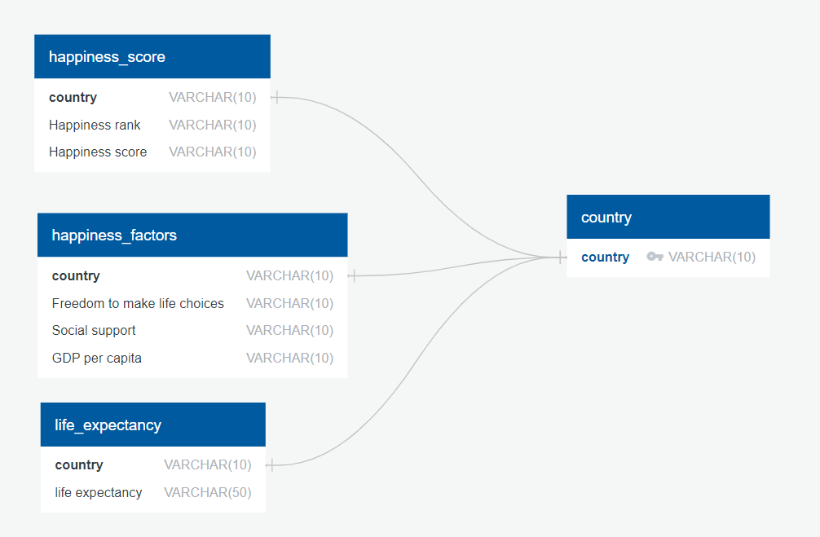
Database modelling - Entity Relationship Diagram
We segregated our data into four different tables to load into the database as shown in ERD
Notes:
Where country is the primary key in the country table while it’s a foreign key in the other 3 tables
Saleha will talk more about the extraction of our data to load into this database structure

Slide 5
Extract
Tools Used
Pandas
PostgreSQL
SQL Alchemy
Data extraction involves pulling data from different sources such as JSON, XML, CSV and converting it into a useful format for further processing or analysis. It is the first step of the Extract-Transform-Load pipeline (ETL) in the data engineering process. Before we create a pandas data frame from the data, it is important to first peek into the file using python’s inbuilt reading library

Slide 6
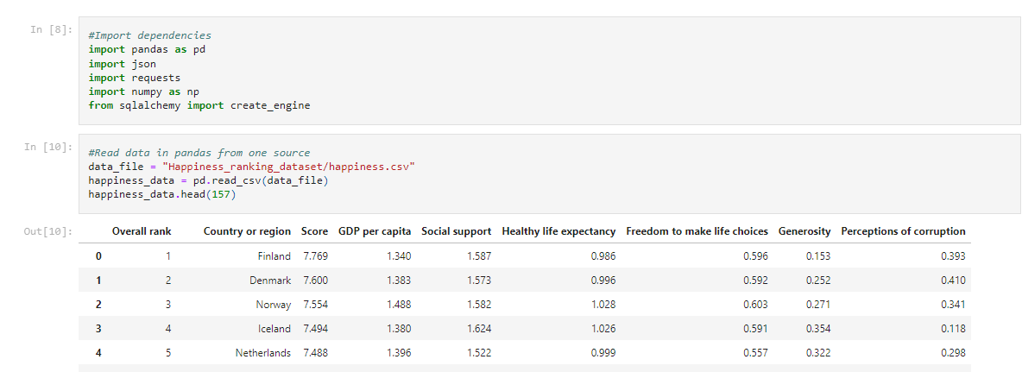
The factors of interest from the World Happiness Report are:
Extract
-Freedom to make life choices
-Social support
-GDP per capita
-Happiness rank
-Happiness score

Slide 7
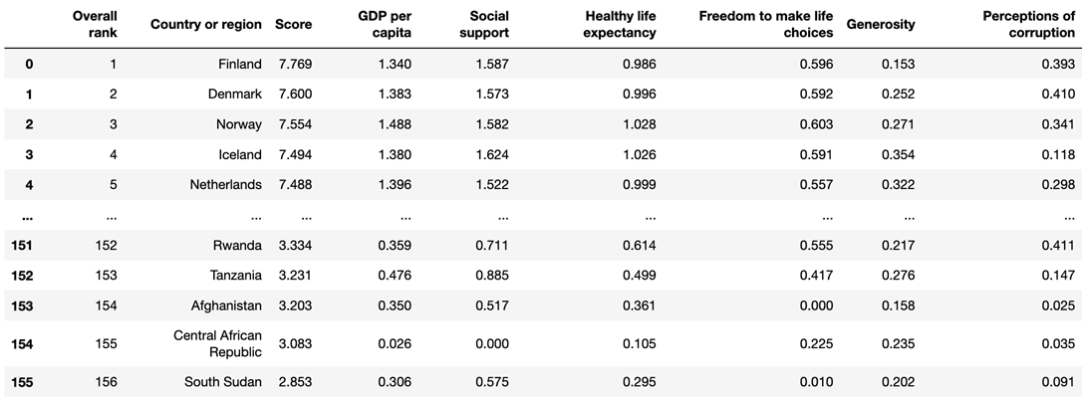
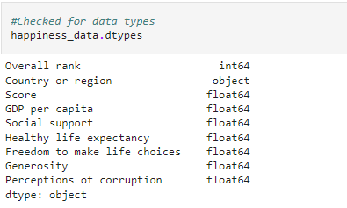
Extract
1. Following the importing of dependencies, firstly we read the csv of the World Happiness and Human Life Expectancy dataset into a pandas dataframe using Jupyter notebook (fig.1, 2)
●The factors of interest from the World Happiness Report are as follows:
-Freedom to make life choices
-Social support
-GDP per capita
-Happiness rank
-Happiness score
●The factors of interest from the World Happiness Report are as follows:
-Freedom to make life choices
-Social support
-GDP per capita
-Happiness rank
-Happiness score

Slide 8
Transform
• Dropped unwanted columns, filtered for selected factors:
Happiness Rank
Happiness Score
Freedom to make life choices
Social support
GDP per capita
Year
• Renamed columns
• Merged data frames based on country

Slide 9
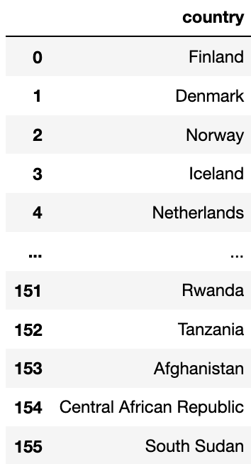
Transform
’Country or region’
Primary Country Data frame
Selected for ‘Country or Region’ column
Renamed column for better comprehension & consistency
Notes:
https://www.carsguide.com.au/car-news/women-are-better-drivers-than-men-report-31199

Slide 10
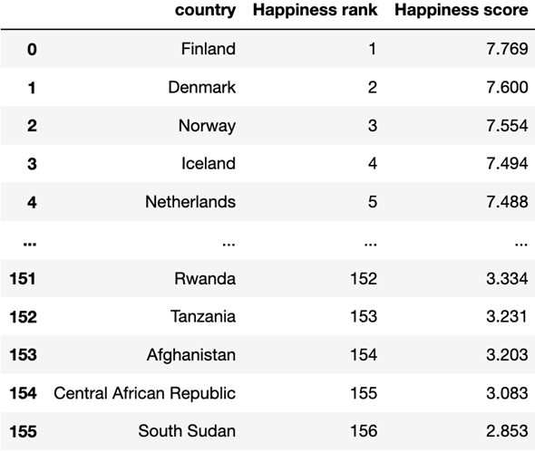
Transform
’Country or region’
‘Overall rank’
‘Score’
Happiness Score Data frame
- Select rank and score
- Rename columns for better comprehension
Notes:
https://www.carsguide.com.au/car-news/women-are-better-drivers-than-men-report-31199

Slide 11
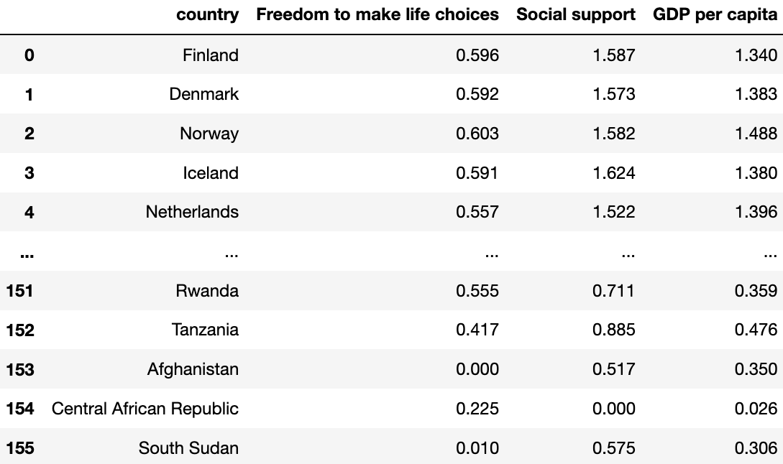
Transform
‘Country or region’
Selected Factors
Happiness Factors Data frame
Select desired factors
Notes:
https://www.carsguide.com.au/car-news/women-are-better-drivers-than-men-report-31199

Slide 12
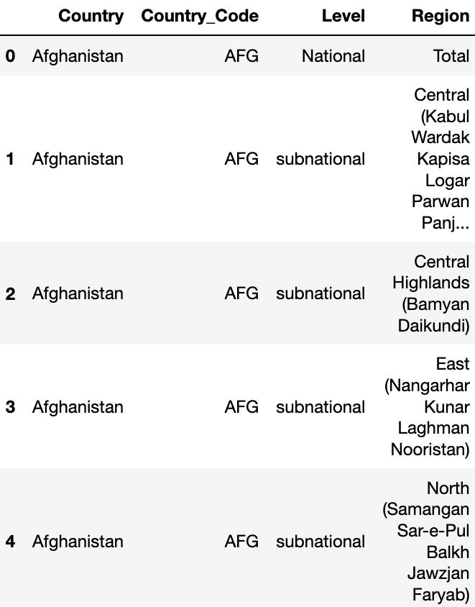
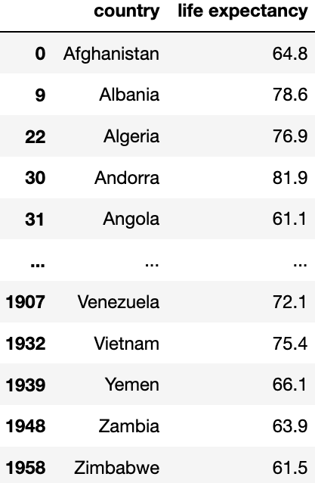
Transform
Life Expectancy Data frame
Filter for specific year (2019) & Country by Region – ‘Total’
2019
Notes:
https://www.carsguide.com.au/car-news/women-are-better-drivers-than-men-report-31199

Slide 13
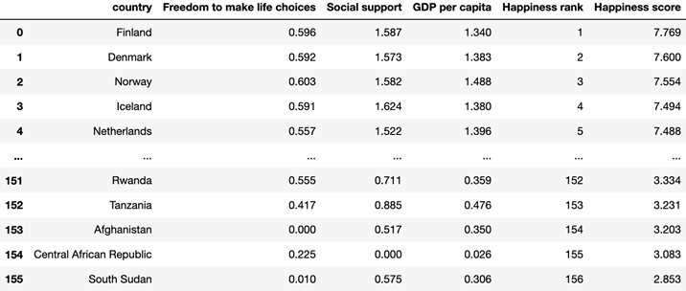
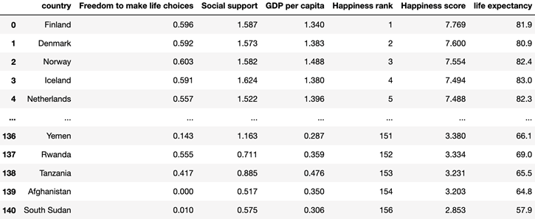
Transform
We also combined the Happiness Factor & Happiness Score data frames and then with the Life Expectancy data frame
Cleaned & merged!

Slide 14

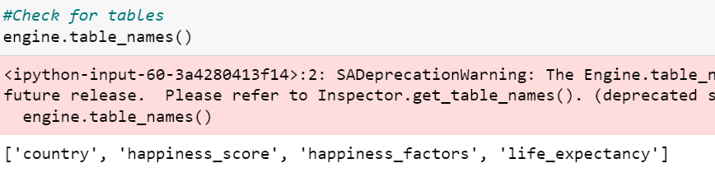
Load
The final process involved loading the two key datasets according to the structure modelled in ERD
This was achieved by creating a connection with the local SQL database and using pandas to load the csv converted data frame to a database.

Slide 15

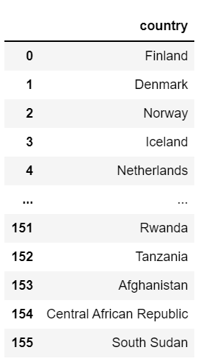
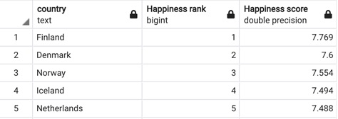

Slide 16
Summary and implications
Our group selected two datasets to identify the specific happiness factors (freedom to make life choices, social support and GDP per capita) and life expectancy rankings across various countries worldwide. The final SQL database output will enable us to determine the countries with the highest and lowest happiness rankings based on our selected factors.
Moreover, further analysis can be performed to determine whether there is a correlation between country, happiness ranking and life expectancy. This can be achieved by generating scatter plots and running linear regressions using the merged data frame from the transformation process.

